Slide 1
Computer Software
Dr. Zahid Halim

Slide 2
Computer Software
Consists of
  computer programs and
  data files (different types)
  that work together to provide instructions and data necessary for carrying out a specific type of task

Slide 3
Software Classification
Software is broadly divided into two classes:
  System software: designed to help the computer carry out the basic operating functions
    Operating systems, utilities, device drivers
  Application software: designed to be used for a specific purpose
    Business / Educational / Medical Software, Computer Games, Web Applications etc

Slide 4
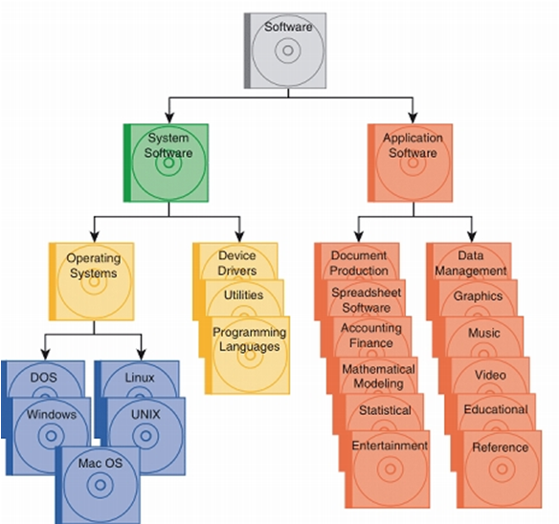
Software Classification

Slide 5




Placement of Software
Application Software
System Software
Hardware

Slide 6
Example
Internet Explorer/ MS Office/ Media Players and so on.
Windows XP
Hardware

Slide 7
Another Example
Firefox/ Open Office/ Media Players and so on.
Linux
Hardware

Slide 8
Examples of Application Software
There is a vast array of application software available for computers that assist in performing a wide range of tasks
  Microsoft Office Suit: Word, Power Point, Excel
  Graphics Software: Adobe Photoshop, Microsoft Paint, Picasa
  Database Software: Oracle, MySQL, Microsoft Access
  Internet & Web: IE, Outlook, Macromedia Dreamweaver
  Multimedia Software
    Codecs, CD ripper, video editing software
  Entertainment Software
    Over $6 billion of computer and video games are sold each year in the U.S. alone

Slide 9
Operating Systems (OS)

Slide 10
Operating System (OS)
The master controller for all of the activities that take place within a computer
  Some of the major tasks carried out by the OS
    Manage system resources e.g.
      Processor
      Memory
      Storage resources
    Ensure that input and output proceed in an orderly manner
    Establish basic elements of the user interface

Slide 11
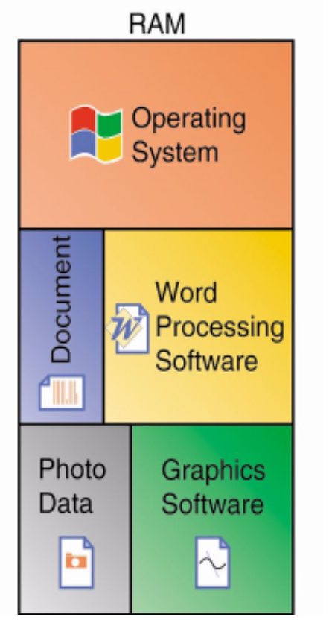
Operating System
Details of some of the OS services
  Memory Management
    Ensures that instructions and data from one area of
    memory don’t “leak” into an area allocated to
    another program
    If it fails, data can get corrupted, programs can
    “crash”
  File Management
    Acts as a filing clerk
    Remembers the names and locations of all your files
    Keeps track of empty spaces where new files can
    be stored

Slide 12
Operating System (OS)
  Note: the OS “hides” details of the operation of hardware from the applications
  This
    tremendously simplifies applications
    and removes their dependence on particular hardware

Slide 13
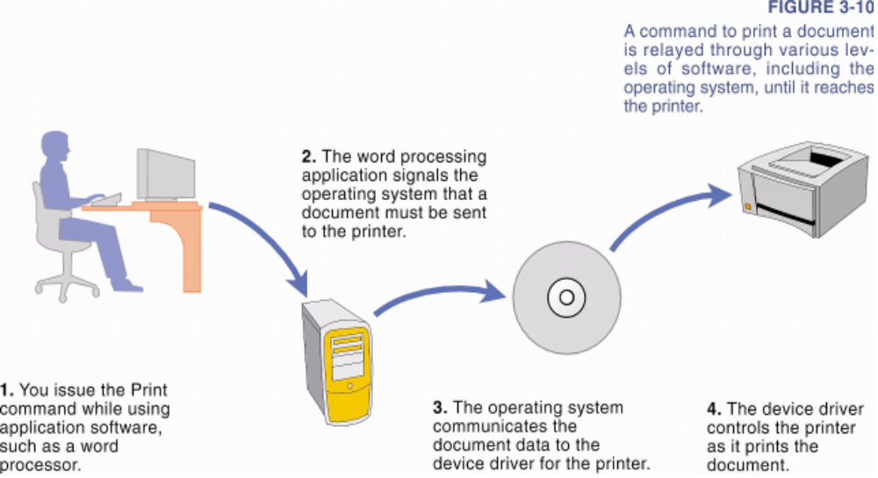
Operating System: Example
Various software work together in a chain of commands to carry out a given task
The role of OS while accessing a printer

Slide 14
Operating System: Example
The following were involved in printing a document:
  Microsoft Word
  Operating System (Windows XP)
  Device Drivers for the Printer
  Printer
Note that except the last one, all of the above are software.
But as a user, your direction interaction is with the first one only!

Slide 15
Operating System (-3-)
Processor Resource Management
  Many activities – called ‘processes’ – compete for the attention of your computer’s microprocessor
    Commands are arriving from programs you’re using
    Input is arriving from keyboard and mouse
    Data must be sent to display device / printer
    Web pages are arriving from your internet connection
  OS ensures that each of these processes is able to get its instructions executed by the microprocessor
    OS helps the microprocessor switch tasks so that everything seems to be happening at the same time

Slide 16
Operating System
  An OS is not strictly limited to computers!
  It is also present on PDAs, Mobile Phones etc [handheld devices]
    Windows Mobile OS, Windows XP Embedded
    Symbian OS
    Palm OS
    Nokia Series 40 and Series 60
    Windows CE

Slide 17
Where is OS stored?
If the OS is small enough, it can be entirely stored in ROM.
Usually OS for a computer is quite large so most of it is stored on a hard disk.

Slide 18
How does the OS start working?
  Switching on a computer initiates a series of POSTs (Power On Self Test). The BIOS is in control at this point.
  Next, the BIOS loads a very small program, placed in the very first location of the hard-disk, into RAM and the processors starts running it. This is called a bootstrap program.
  Now, this small program will load the much bigger OS (e.g. Windows XP) from the hard disk. Initially, the Windows’ Kernel is loaded.

Slide 19
A little about the Kernel
    Kernel provides the most essential OS services
    It stays in memory all the time your computer is powered on.
    Other parts are loaded into memory as needed

Slide 20
Firmware
A term sometimes used to denote the fixed, usually rather small, programs that internally control various electronic devices
  E.g., remote controls, keyboards, digital cameras etc contain firmware to enable the device’s basic operations as well as implementing higher level functions
    Typically reside in ROM
    More complex reside in flash memory to allow for updates

Slide 21
Example of firmware
    Timing control systems in washing machine
    BIOS found in PC
    Controlling sound / video attributes, channel lists in TVs

Slide 22
History of the Internet
The Internet enables
  Quick and easy communication via e-mail
  International networking of computers
Packet switching
  Transfers digital data via small packets
  Allows multiple users to send and receive data simultaneously
No centralized control
  If one part of the Internet fails, other parts can still operate
Bandwidth
  Carrying capacity of communications lines

Slide 23
Network Building Blocks

Slide 24
What is networking?
In the world of computers, networking is the practice of linking two or more computing devices together for the purpose of sharing data.
Networks are built with a mix of computer hardware and computer software.
http://compnetworking.about.com/cs/basicnetworking/f/whatsnetworking.htm

Slide 25
Advantages of Networking
Sharing networked hardware can
  reduce costs (through shared printers, and etc.)
  provide access to a wide range of services and specialized peripheral devices (such as scanners, photo printers, plotters and etc.)
Sharing networked software can also reduce cost
  buying software licenses for the network is usually cheaper as compared to buying individual license for each PC
Sharing data on a network is easy
  data can be copied between networked devices much more easily and efficiently as compared to between standalone devices using removable storage media
Networking enables people to work together regardless of time and space
  email
  instant messaging
  online conferences and webcasts

Slide 26
Disadvantages/Challenges Posed by Networking
Vulnerability to unauthorized access.
  intruders from across the globe can access data stored on the shared servers
  wireless networks can be tapped from a specially equipped “snooping” computer in a car being driven by a hacker
  vulnerability to malicious code
    e.g. Malicious code used by the hackers
      to monitor keystrokes
      capture passwords and login information
      Interrupt email and other private communications/trasmissions
  susceptible to an ever increasing number of works, Trojan horses and etc.

Slide 27
Disadvantages/Challenges Posed by Networking
Trojan Horse
    A destructive program that attacks disquised as a harmless application
    Unlike viruses, Trojan horses do not replicate themselves, but they can be just as destructive.
    One of the most insidious types of Trojan horse is a program that claims to rid a computer of viruses but instead introduces viruses onto the computer
Eavesdropping
  Eavesdropping is the act of secretly listening to the private conversation of others, such as a phone call, instant message, video conference or etc. ,without their consent
  The term drives from the practice of actually standing under the eaves of a house, listening to conversation inside.

Slide 28
Disadvantages/Challenges Posed by Networking
Snooping
  An authorized access to another person’s/company’s data.
  Similar to eavesdropping, though not limited to gaining access to data during transmission
  Can also include
    casual observance of an email that appears on another’s PC screen
    watching what some someone else is typing
    watching other PC(s) using remotely monitoring software
    monitoring of the activities of the employees and track internet usage by corporations
    collecting terrorism related information by the government
  Can refer to any program or utility that performs monitoring function, e.g.
    snooper servers are used to capture network traffic for analysis
    Snooping protocol monitoring information on a computer bus to ensure efficient processing

Slide 29
Network Classifications
Networks can be classified based on
  geographical scope
    Network Technologies: WAN, MAN, LAN, PAN
  organizational structure
    Network Technologies: client /server, peer-to-peer
  physical topology
    Network Technologies: star, bus, ring, mesh, tree
  network links
    Network Technologies: twisted-pair cable, coaxial cable, fiber-optic cable, RF signals, microwaves, infrared light, power line, phone line
  bandwidth
    Network Technologies: broadband, narrowband
  communication protocols
    Network Technologies: TCP/IP, SPX/IPX and etc.

Slide 30





Physical Topology
Star
Topology
Full Mesh
Topology
Bus Topology
Hybrid Topology
Tree backbone with bus networks
Ring Topology

Slide 31
Geographical Scope
Personal Area Network (PAN )
  typically a wireless interconnection of personal digital devices within a range of about 30 feet
Local Area Network (LAN)
  typically connects personal computers (wired/wireless) within a small geographical area- a building or a small facility.
Metropolitan Area Network (MAN)
  a public high network capable of voice and data transmission within a range of 50 miles (80 km).
    e.g., local ISPs. cable television companies and etc.
Wide Area Network (WAN)
  covers a large geographical area
  typically consists of several smaller subnetworks
  the subnetworks may use different platforms, technologies/protocols.
  Example: Internet

Slide 32
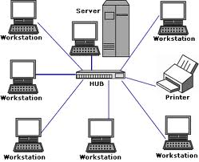
LAN: Example

Slide 33
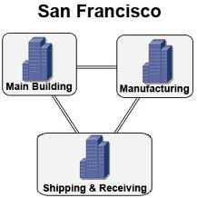
MAN: Example

Slide 34
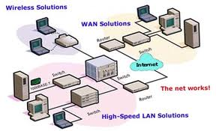
WAN: Example

Slide 35
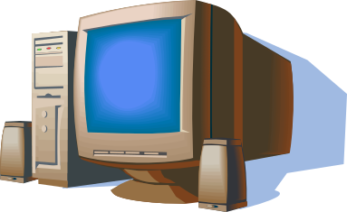
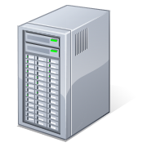
Organizational Structure
Client
Client
Client Server
Server
Client
Peer-to-Peer
Workstation
Workstation
Workstation

Slide 36
References
Computer Concepts, by Parsons & Oja
[Chapters 3]

